Slide 1
HOW MRA IS SUPPORTING MYANMAR MARKET RESEARCH INDUSTRY AND TRADE ASSOCIATIONS
Presented by:
Thurein Nyein – Vice Chairman (1)

Slide 2
IND SIZE
USD 20 + MIL
MEDIA
CONSUMER
SOCIAL
INDUSTRY/ TRADE
RETAIL
The professional association comprised of Myanmar’s leading research companies and researchers that aims to upgrade and promote the research industry by …
Increasing the value of research professionals
Distributing professional knowledge and procedures to new researchers
Monitoring & Evaluating the Standard Code of Conduct
Establishing Myanmar socio-economic indicators …

Slide 3
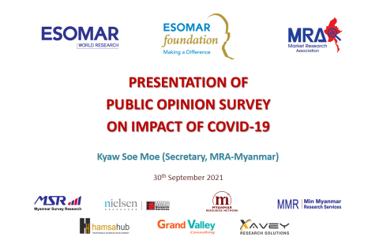
SUPPORTS TO THE RESEARCH INDUSTRY …
TRAININGS
SEMINARS & WORKSHOPS
SURVEYS
Basic level market research training
Mid-level market research training
Mid-level ESOMAR research training
Job Creation for Field Staffs
Status Update on current Issues
Standardizations
Industry Updates
Knowledge Sharing
Consumers & Market Information

Slide 4
SUPPORTS TO THE TRADE ASSOCIATIONS …
Industry Overview
Industry Review
Member Satisfaction Survey
COVID/ Political Impact on Industry
Industry Labor Survey
Industry White Paper/ Policy Paper

Slide 5
Thank You!

